Slide 1

Weekly Seminar
Feb. 12. 2023. Ash-hun

Slide 2
Index
Machine Learning Work
Daily Mission
Programmers Algorithm
PCCP
AI Feel Research Course
Next Week

Slide 3

Machine Learning Work
NLP RoadMap Go!

Slide 4
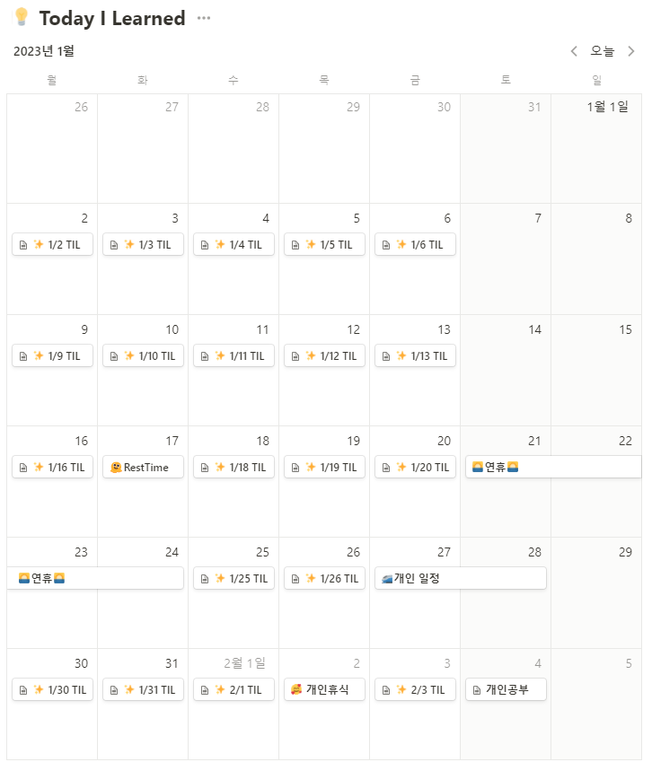
Daily Mission

Slide 5
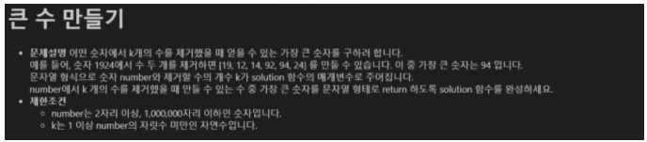
Programmers Algorithm

Slide 6
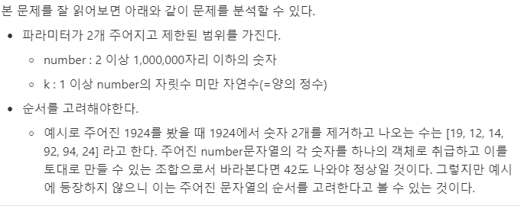
Programmers Algorithm

Slide 7
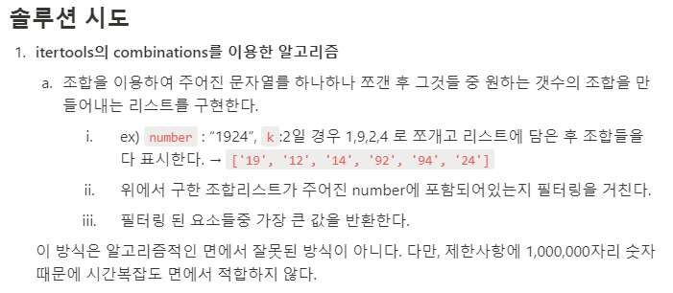
Programmers Algorithm

Slide 8
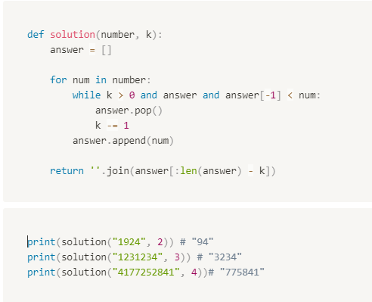
Programmers Algorithm

Slide 9
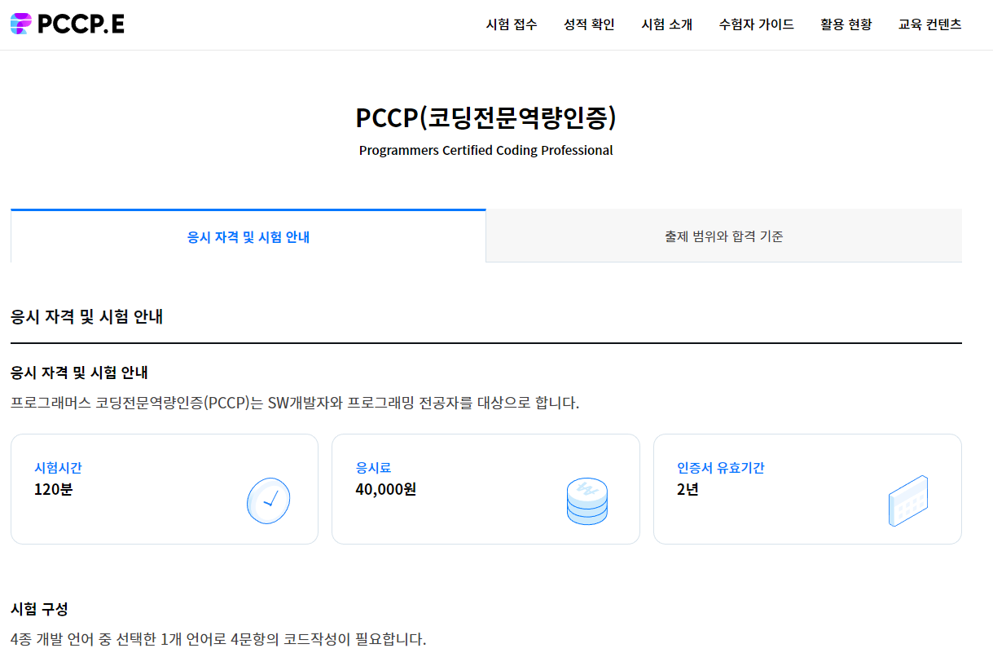
PCCP

Slide 10
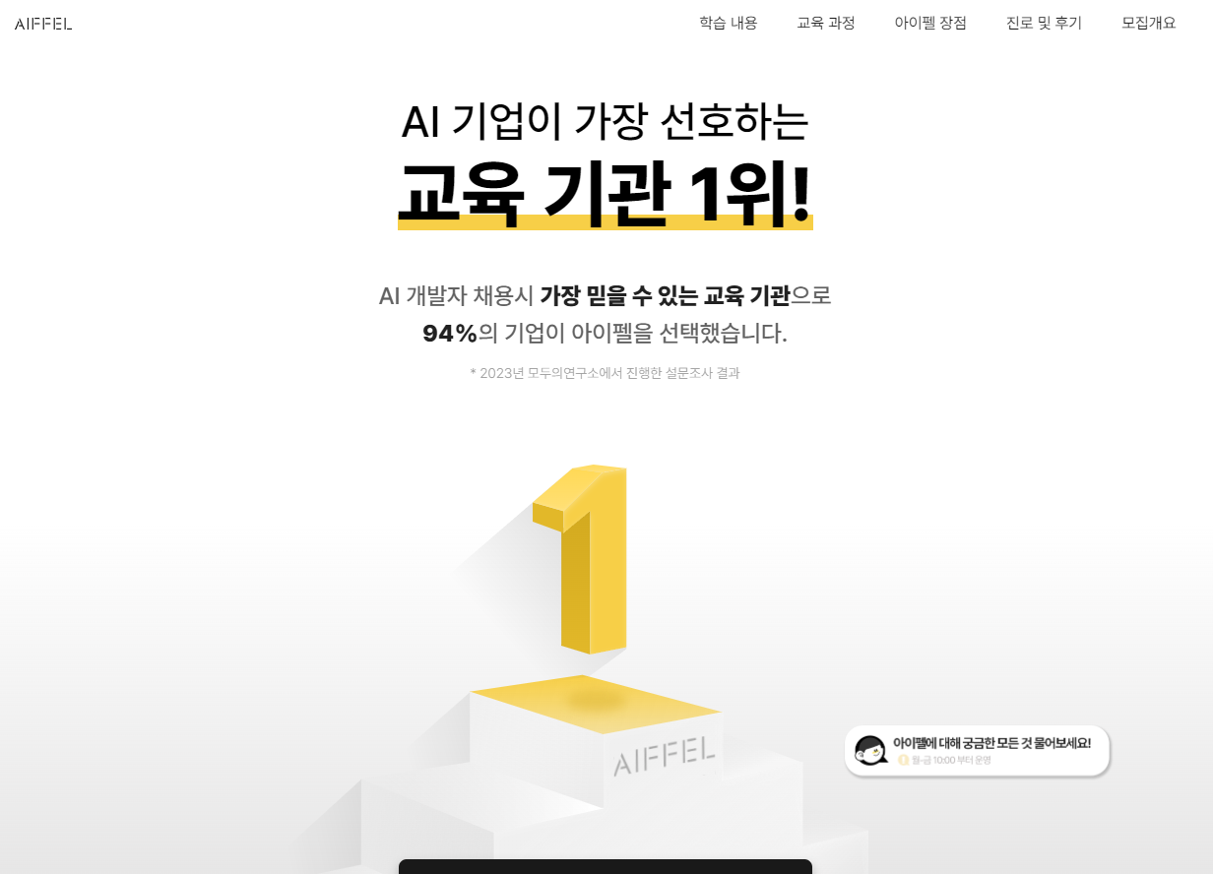
AI Feel Research Course

Slide 11
Next Week
Everyday 👉 Daily Mission
Monday 👉 AI Feel 2nd Meeting
Tuesday 👉 BigCon-Career Book Talk
Wednesday 👉
Thursday 👉 Pray2U Event
Saturday 👉 x
Sunday 👉 Abara Seminar

